Slide 1
PROJECT RAPTORS REBOUND
DAT 205 Capstone Interim Progress
Group 1 - Bhavika Patil, Cindy Guo, Dennis Hung
Notes:
Good evening Everyone,
Today we are going to present our Interim Progress Report
Our group consists of [Pick an order “Bhavika, Cindy, Dennis”] and myself.
[NEXT SLIDE]

Slide 2
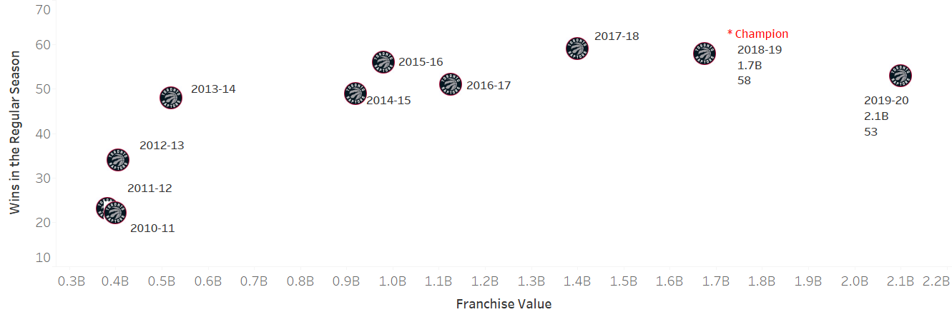
The Client
The Toronto Raptors are an NBA championship team with a $2.1 billion market capitalization in 2020.
The team’s General Manager (GM) and owners are seeking recommendations on improving the team’s chances at another championship run while preserving the team’s long-term future.
Notes:
The Client
[NEXT 01 – Graph]
Pause for effect
[NEXT 02 – Raptors]
Toronto Raptors, Canadian professional basketball team based in Toronto that plays in National Basketball Association known as NBA. The Raptors have won one conference title and one NBA championship (both 2019).
The team was founded in 1995 as part of the NBA's expansion into Canada, along with the Vancouver Grizzlies. Since the 2001–02 season, the Raptors have been the only Canadian-based team in the league.
As of 2020, The Toronto Raptors are worth 2.1 billion USD. There were key players added in 2019 who contributed to critical wins during the season and championship playoff run. However, the team has been in decline since being crowned 2019 NBA champions.
[NEXT 03 – GM]
The team’s General Manager (GM) and owners are seeking recommendations on improving the team’s chances at another championship run while preserving the team’s long-term future. The recommendations will be in the form of marginal/minor improvements to the player roster. The stakeholders intend to either maintain or improve on the number of wins during the regular season and more importantly during the playoffs.
The organization wants to retain a public interest in the team while improving the team’s performance without rebuilding the entire team. A spot in the NBA finals while maintaining the number of regular-season wins would be ideal.
[NEXT SLIDE]

Slide 3
Objectives
The primary objective of this analysis is to determine which features are important to the Toronto Raptors team to produce more wins in the regular season and the playoffs.
The secondary objective is to review team players’ performance-to-cost effectiveness.
Focus on the historical player data from 2005 to 2020 as this closely represent the players of the current era.
Notes:
To attain the requirements outlined by the management, we are looking to determine what features affect team wins/losses and predict how this can be improved/reduced through changes in the team’s roster.
[NEXT 01 – Primary Objective]
The primary objective of this analysis is to determine which features are important to the Toronto Raptors team to produce more wins in the regular season and the playoffs.
[NEXT 02 - Secondary Objective]
The secondary objective is to review team players’ performance-to-cost effectiveness.
[NEXT 03 – Data scop]
The scope of this analysis will be to focus on the historical player data from 2005 to 2020 as this closely represent the players of the current era. The performance baseline of the team and players will be established using the data for The Toronto Raptors 2019-2020 season. These statistics will be used to indicate performance features for the team and the individual players.
[NEXT SLIDE]

Slide 4
Methods for Data collection
Open access API (nba_api)
PlayerGameLogs End point
Parameters required – Season, Season type
Total 465065 records, 66 features
PlayByPlay End point
Parameters required – GameId
Total ~10M records, 13 features
NBA Player Salaries
ESPN for the historical data
Hoopshype for future
Approx ~500 records
Gathered by web scraping (Beautiful Soup Python Package)
Notes:
The data collection for this analysis was a cumbersome process. We have used multiple sources to gather the data.
Primary data used for this analysis is hosted by nba.com; It is made available via webservices through stats.nba.com.
[NEXT 01 – API]
nba_api is an open access API client library for Python developed by Swar Patel. There are more than 250 endpoint available. This API will give very close to real time data for any event happening.
(if asked: An endpoint is a URL pattern used to communicate with an API.)
[NEXT 02 – Player Game Logs endpoint]
We use playergamelogs endpoint of the API to pull out player statistics by game.
We need season and seasontype as required parameters. There are more than 22000 games in this dataset consisting of total 465065 rows and 66 columns. We have dropped about 30 features since they are irrelevant for measuring the performances.
[NEXT 03 – Play by Play endpoint]
We use PlayByPlay enedpoint to fetch the playbyplay data for each game we have as part of the first dataset. This took some time since we had to add some waiting time between API requests. It did take more than a day to get data for 22000 games.
[NEXT 04 – Player salaries]
NBA webservice does not provide the salary data. We ended up using additional means of data collection.
We fetched the past salary data from ESPN website and the future salary data from HoopsHype website. These were obtained using web scraping in python using web scraping library. We have 489 entries for this dataset.
[Just pause for a couple of seconds]
[NEXT SLIDE]

Slide 5
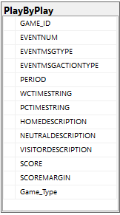
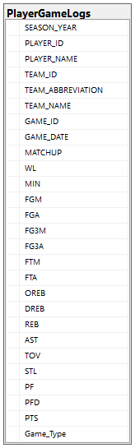
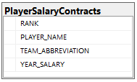
Database diagram
Arrows represent relationship
Not normalized
SQL and Visio used to visualize the relationships
Notes:
To easily explain the schema, we created this database diagram using SQL and visio. Since this is not a normalized database; which would be very expensive for this analysis, the primary and foreign keys are not enforced by a constraint.
[NEXT 01 – Player Game Logs table]
We are only showing a few features here, this table acts as the main table based on which we pull data for other components.
[NEXT 02 – Play by Play table]
This table is generated by the Game ID from the Player Game logs. This represents each activity happened in a game.
[NEXT 03 – Player salaries table]
We can relate this table to the Playergamelogs using the Player name and the Team Abbreviation.
[Just pause for a couple of seconds]
[Next speaker handoff statement]
Now I shall hand off to Dennis
[NEXT SLIDE]

Slide 6
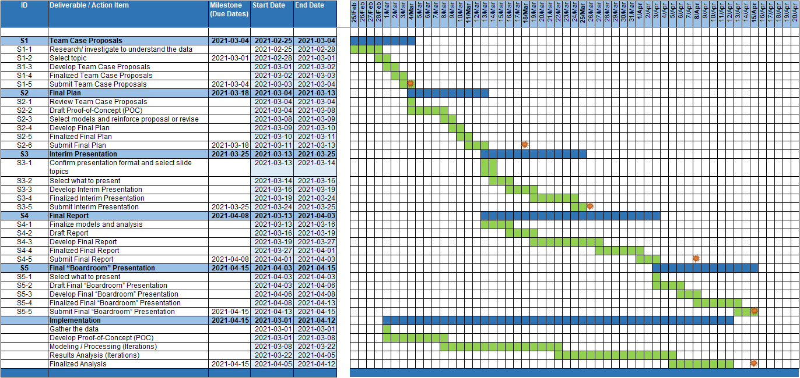
Project Planning
Notes:
[Dennis to take over,]
Thank you Bhavika. I will continue on to the next part of Project Planning.
[NEXT 01 – Project plan]
Our project plan is allocation into 5 phases
[NEXT 02 – Project plan]
Proposal, Final Plan, Interim Presentation, Final Report and Final Presentation
[NEXT 03 – milestone]
with a milestone to show the deliverable at the end of each phase:
[NEXT 04 – Final date]
Completion of the final report is targeted for Apr 15th along with a presentation to summarizing the recommendations outlined in this report.
[NEXT 05 – Implementation]
The last unlabeled grouping was to track our overall development schedule relative to the our primary deliverables.
[NEXT SLIDE]

Slide 7
Project Team
Team Roles
Project Manager
Data Scientist
Programming Architect
Team communications
Schedule meetings (3+ times per week)
MS Teams, WhatsApp, email
Git and Google Drive
Notes:
[NEXT 01 – Team]
Our team was a very loose form of Scrum Agile. If we need to designate roles it was
[NEXT 02, 03, 04 – Roles]
Project Manager where I (Dennis) handled scheduling and administrative duties
Data Architect where Cindy’s role to help understand the data and some initial trends in the data.
Programming Architect where Bhavika’s role taking care of our business unit’s division of coders (everyone in the group)
[NEXT 05 – Communications]
We had multiple methods to facilitate team communications
[NEXT 06 – Meetings]
We had scheduled meetings 3 times per week to align on
what each of us had done
what we will do next
discuss challenges, next steps, and shared knowledge
[NEXT 07 – Meetings]
Various methods (MS Teams, WhatsApp, Email) to contact each other for redundancy as technology can fail
[NEXT 08 – Repositories]
Use repositories such as Git and Google Drive to maintain our documentation and code
This agreed upon structure helped facilitate our team relationships to work effectively and especially share knowledge. Only 1 of the 3 members had specific understanding of the subject which was passed along to the group as we all became more familiar with the data. We created documents () to retain useful information, techniques, and ideas for future reference. All of this was stored on Google Drive before going with Git as the main repository for this project.
[Next speak handoff statement]
Now I shall hand off to Cindy
[NEXT SLIDE]

Slide 8
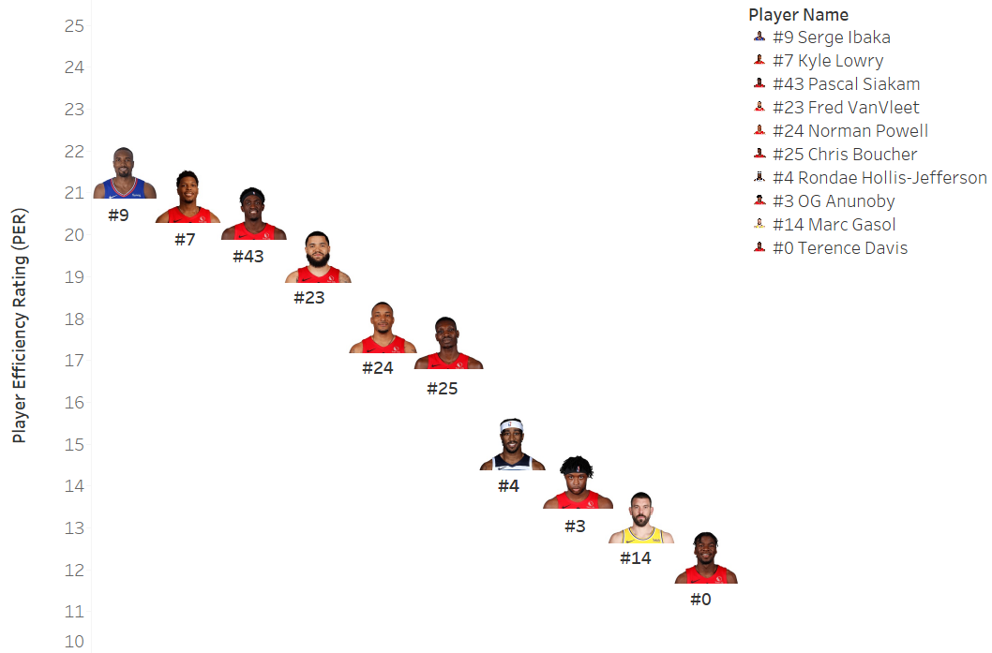
Initial Analysis
Top 10 Toronto Raptors Player Efficiency Rating (PER) for Season Year 2019-20
PER=[ FGM x 85.910 + Steals x 53.897+ 3PTM x 51.757 + FTM x 46.845 + Blocks x 39.190 + Offensive_Reb x 39.190 + Assists x 34.677
+ Defensive_Reb x 14.707 - Foul x 17.174 - FT_Miss x 20.091 - FG_Miss x 39.190- TO x 53.897 ] x (1 / Minutes)
Notes:
[Cindy to take over]
Thank you, Dennis. I will continue on to the next part of Initial Analysis.
In order to understand the player and team performance, we first analyze the Player Game Log Data. We have data for each player in each game. There are more than 400M records. We consider Toronto Raptors as a reference to assess other leagues.
[NEXT 01 – The slide is to show the topic for our study]
First, we try to find out the most efficient players for Toronto Raptors in the season 2019-20. The Player Efficiency Rating (PER) is introduced in our analysis.
PER is John Hollinger's all-in-one basketball rating, which attempts to boil down all of a player's contributions into one number. The formula is listed as below.
[NEXT 02 – The slide is to show the formula]
PER takes into account accomplishments, such as field goals, free throws, 3-pointers, assists, rebounds, blocks and steals, and negative results, such as missed shots, turnovers and personal fouls. The formula adds positive stats and subtracts negative ones through a statistical point value system. The rating for each player is then adjusted to a per-minute basis.
There are other PER formulas as well which may be different from the one we use.
[NEXT 03 – Player Performance Graph]
This graph is to show the top 10 Player Efficiency Rating for Toronto Raptors in the Season 2019-20. The horizontal axis is the player names. The vertical axis is the PER number for each player. The analysis includes both Regular and Playoffs.
[NEXT 04 – Jersey]
The Jersey number is highlighted for each player under the photo.
[NEXT 05 – Serge]
From the PER calculation, Serge ranked No.1 in the season 2019-20 with a value of 21.50.
[NEXT SLIDE]

Slide 9
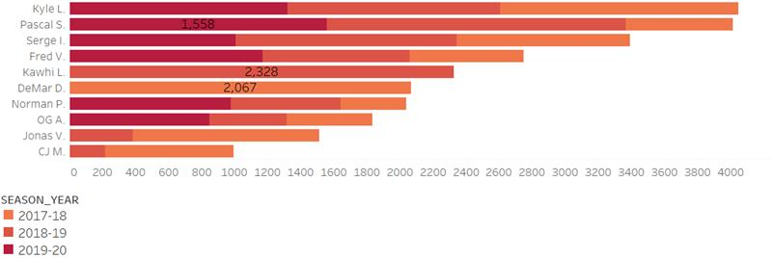
Initial Analysis
Top 10 Toronto Raptors Players by Points for the Seasons 2017-2020
Notes:
[NEXT 01 – Top 10 Toronto Raptors Players by points for the past 3 Seasons]
Let’s talk about who scored the most points in the last 3 seasons.
[NEXT 02 – Graph]
In this graph, it shows the top 10 players and their points. The horizontal axis is the total points scored in the last 3 seasons. The vertical axis is the player names.
We only study the players who scored at least 100 points in both Regular and Playoffs. The different color on the stack bar is for the different seasons. The high grade indicates the recent season. Some players may have contracts with Raptors for only one season, we will see one color on the stack bar.
[NEXT 03 – DeMar]
In 2017-18 season, DeMar was No. 1 with 2067 points.
[NEXT 04 – Kawhi]
In 2018-19 season, Kawhi had the highest score with 2328 points.
[NEXT 05 – Pascal]
In 2019-20 season, Pascal Ranked No. 1 with 1558 points.
[NEXT 06 – Kyle]
In all 3 seasons, Kyle scored the highest points and followed by Pascal.
[Next speaker handoff statement]
Now I shall hand off back to Dennis
[NEXT SLIDE]

Slide 10
Preliminary Results
Correlation Matrix
Notes:
[Dennis to take over,]
I will continue on to the next part of the Preliminary Results.
Add in Heat Map
Result before fine-tuning
Ratings of the models
Important Features (top 5) (+/- Lucky bastard effect)
[NEXT 0x – key statement for animation]
[Speaker’s talking points on the current slide item]
[NEXT SLIDE]

Slide 11
Preliminary Recommendations
Model results (Accuracy … Feature Importance
Random forest
Notes:
Model results (Accuracy … Feature Importance
Random forest
[NEXT 0x – key statement for animation]
[Speaker’s talking points on the current slide item]
[NEXT SLIDE]

Slide 12
[Template - Insert Title]
Notes:
[name to take over,]
Thank you, [Insert name]. Hello all, this is [Insert name]. I will continue to talk about [Insert next subject].
Thank you [Insert name]. I will continue on to the next part of [Insert next subject].
[NEXT 0x – key statement for animation]
[Speaker’s talking points on the current slide item]
[Next speak handoff statement]
Now I shall hand off to [Insert name]
[NEXT SLIDE]

Slide 13
Assumptions
01
Toronto Raptors only Play for NBA
02
The stats of games before 2005 are irreverent for current performers
Notes:
[NEXT 0x – key statement for animation]
[Speaker’s talking points on the current slide item]
[NEXT SLIDE]

Slide 14

THANK YOU
Notes:
This concludes our interim progress presentation.
Are there any questions?
Are there any ideas or suggestions?

